Slide 1

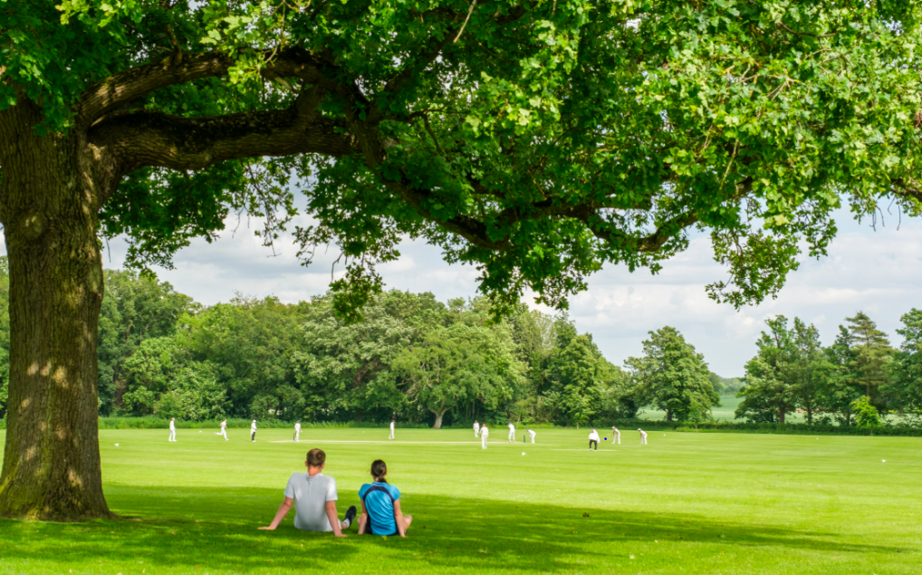
Wymondham
College
Options
SUBJECT: AQA Physical Education
Instagram: wymondham_ college_pe_dept

Slide 2
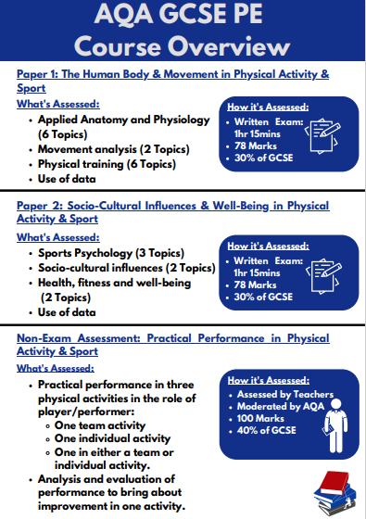
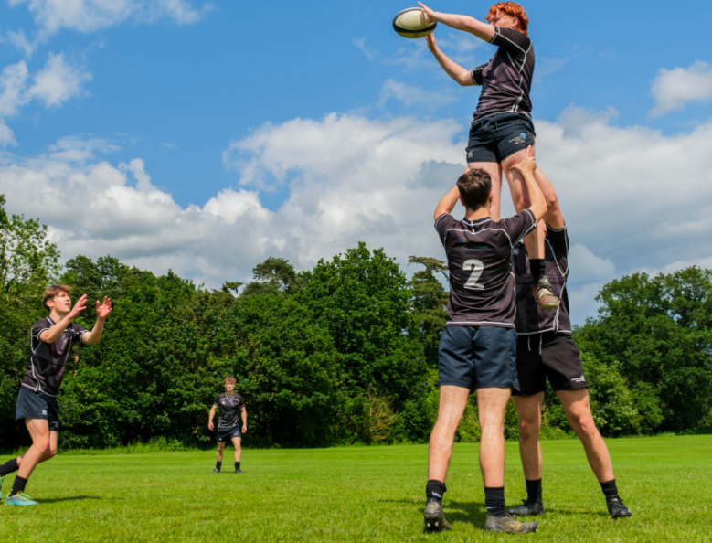
Subject Overview

Slide 3
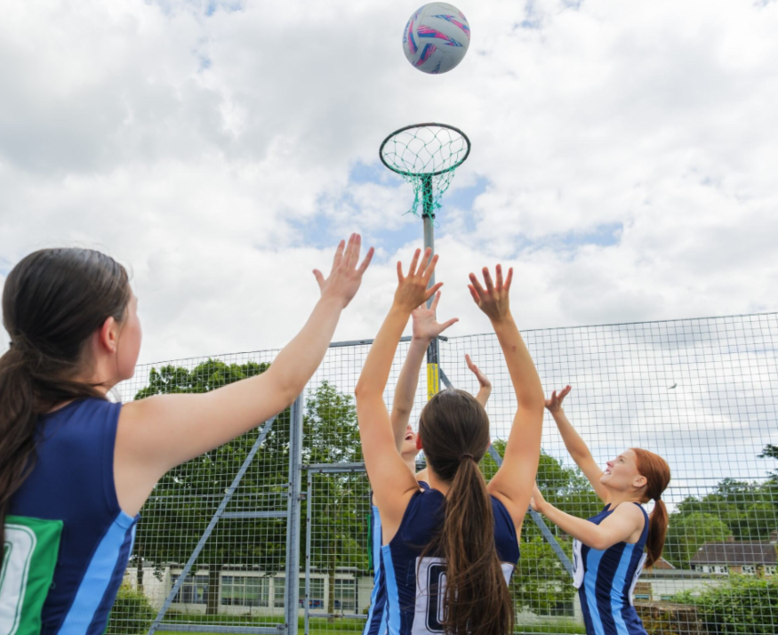
Expectations
60% of AQA GCSE PE is theoretical. Students should have an interest in learning about the body and mind in sport.
Students should be attending after school sports clubs regularly.
Students should be playing competitive sport, both inside and outside of school.
30% of student's grades will come from three practical sports. Students should be willing to play and learn a variety of sports.
Students will also complete a piece of coursework analysing and evaluating how to bring about improvement in one activity.

Slide 4
Guidance on how the course supports future academic pathways or careers.
Study A-Level Physical Education at Wymondham College.
Undertake the Btec Level 3 Extended Diploma in Sport Course. This is the equivalent of 3 A-Levels and offers students the opportunity to study sport full time.
Both courses can support careers in teaching, coaching, strength and conditioning, nutrition, and a range of careers in sport and leisure industry.

