Slide 1


Wymondham
College Options
HISTORY

Slide 2
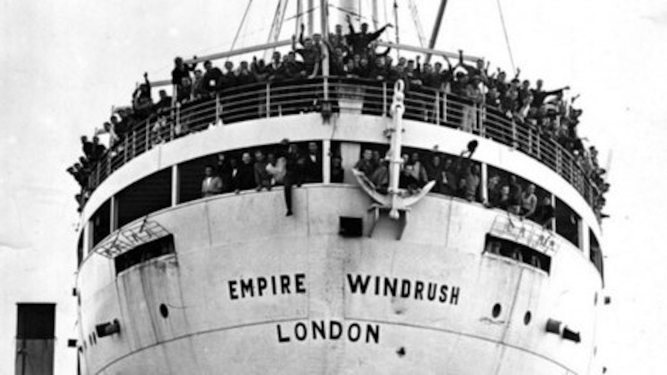
An overview of your subject. Course structure and content.
There are FOUR topics taught across THREE years
In Yr9 we teach Britain: Migration, Empire and the People
In Yr10 we teach Elizabethan England and start Conflict & Tension: The First World War
In Yr11 we complete Conflict & Tension: The First World War and teach Germany, 1890-1945
There will be a 1hr exam on each of the four topics at the end

Slide 3
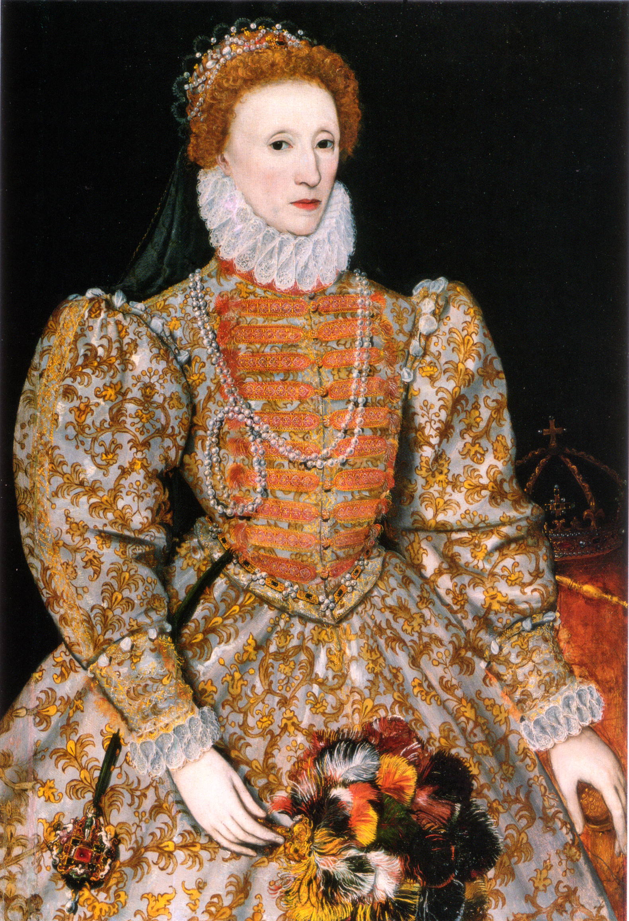
Expectations regarding student commitment, including workload and deadlines. Any coursework or practical elements involved.
There are FOUR exams at the end of the course, which require extended writing, some of the marks are awarded for SPaG (Spelling, Punctuation and Grammar)
Prep tasks will include revision that requires pupils to learn and memorise information
There is no coursework

Slide 4
Guidance on how the course supports future academic pathways or careers.
History is a highly-valued and respected academic subject that opens many different routes and career paths
History is often referred to as an ‘enabling subject’ because it helps you to demonstrate important key skills including written communication, analysis and evaluation, handling sources of information, weighing evidence
GCSE History is a good preparation for History, Politics, Law and other subjects at A Level in Sixth Form
Careers that History will be helpful for including: law; journalism; public relations; civil service; and, teaching.

