Slide 1


Wymondham
College Options Subject:
Food Preparation and Nutrition

Slide 2
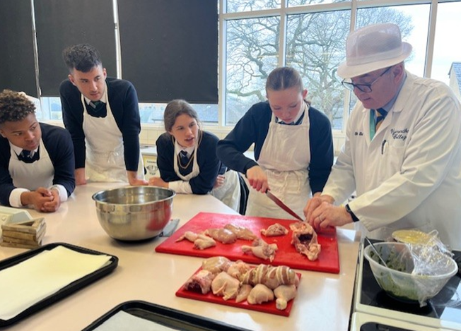
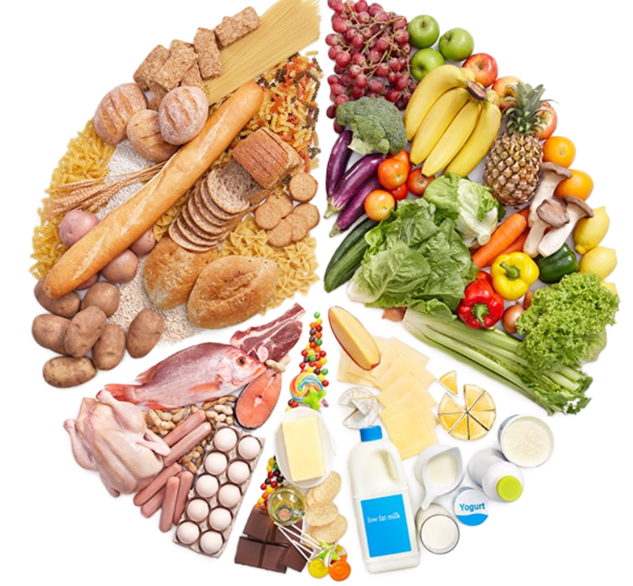
Subject overview. Course structure and content.
Food Preparation and Nutrition focuses on developing a thorough understanding of nutrition, food origins, human dietary requirements and the working characteristics of ingredients both through theory lessons and in practical cooking lessons.
Students should expect five lessons a fortnight, two of which will either be making a food product or conducting a food science experiment.
Food Prep and Nutrition pairs well with chemistry, biology and sports studies and has the bonus of developing food preparation skills for life.
Course Content
1. Food commodities e.g. cereals, fruit and vegetables, sugars, dairy, fats , meat/fish and vegetarian alternatives. The course will look at their value in the diet, their working characteristics, experiments to understand changes occurring during cooking and also current recommended guidelines for a healthy diet
2. Principles of nutrition - the role of the main nutrients in the diet, their sources, function and deficiencies.
3. Diet and good health – studying the nutritional needs that change during life and how to plan diets to suit them. Looking at food choice including culture and religion, as well as dietary needs.
4. The science of food - the scientific principles behind preparing and cooking foods.
5. Where food comes from – food provenance, sustainability and its security and the impact on the environment.
6. Cooking and food preparation – range of practical tasks using all the commodity groups to demonstrate a variety of skills and techniques.

Slide 3
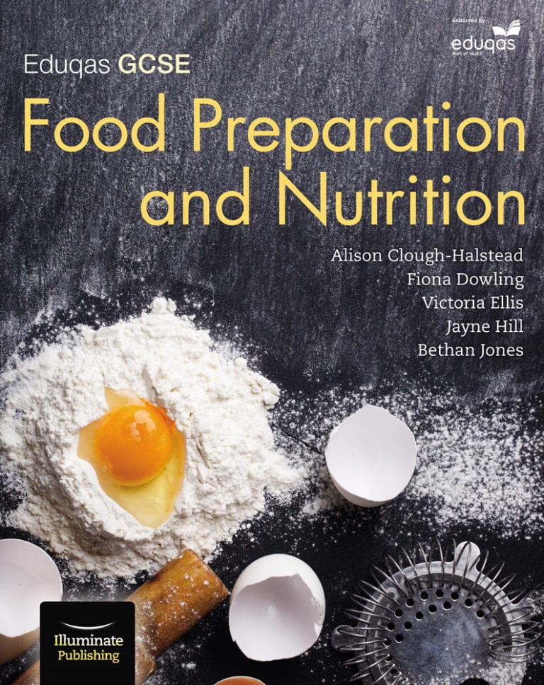
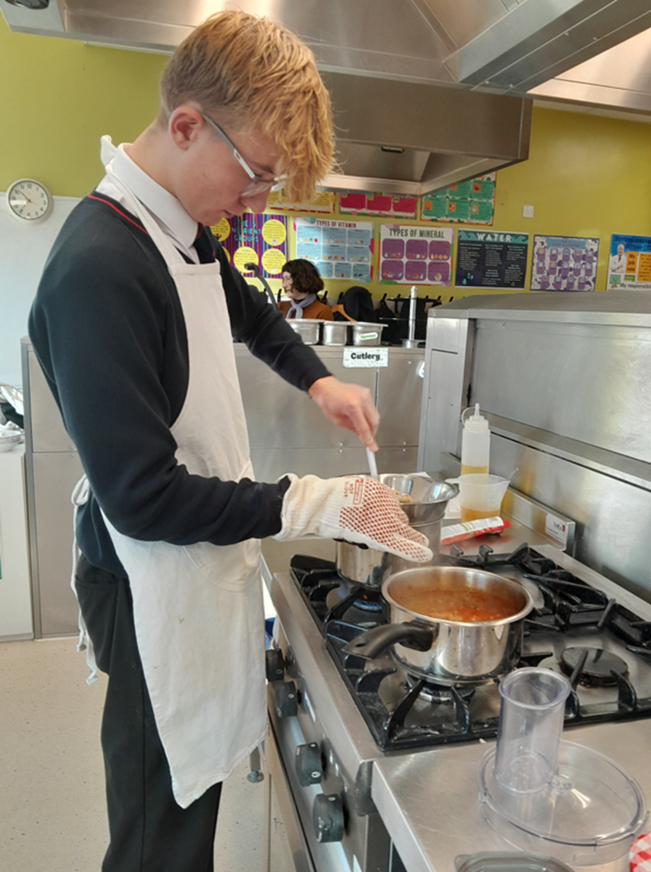
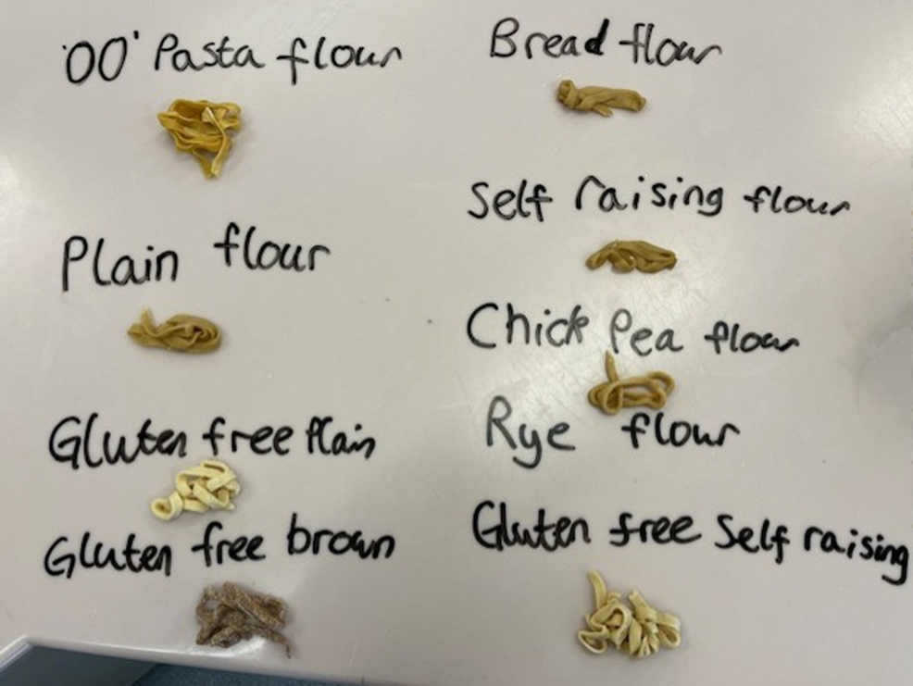
Student Expectations.
Expectations
Students will be expected to participate fully in all practical and theory lessons, prep is set weekly and includes project work, research and revision, both paper based and online.
In year 9 we focus on the basics of nutrition and food choice, in year 10 we study each commodity group and the provenance and food science that goes with it.
In both years students will undertake mock NEAs to prepare them for the coursework in year 11.
In year 11 the NEA1 is launched on the 1st of September and the NEA2 on the 1st of November. NEA work will take place during lessons and all revision will be set for prep.
Assessment
Component 1: Principles of Food Preparation and Nutrition
Written examination: 1 hour 45 minutes
50% of qualification
This unit will consist of two sections both containing compulsory questions and will assess the theory content of the GCSE specification.
Section A: questions based on specified topics.
Section B: structured, short and extended response questions to assess content related to food preparation and nutrition.
Component 2: Two Non-Examined Assessments: internally assessed, externally moderated
Food Preparation and Nutrition in Action
Assessment 1: The Food Investigation Assessment 8 hours
A scientific food investigation which will assess the learner's knowledge, skills and understanding in relation to scientific principles underlying the preparation and cooking of food.
Assessment 2: The Food Preparation Assessment 12 hours
Prepare, cook and present a menu which assesses the learner’s knowledge, skills and understanding in relation to the planning, preparation, cooking and presentation of food.

Slide 4
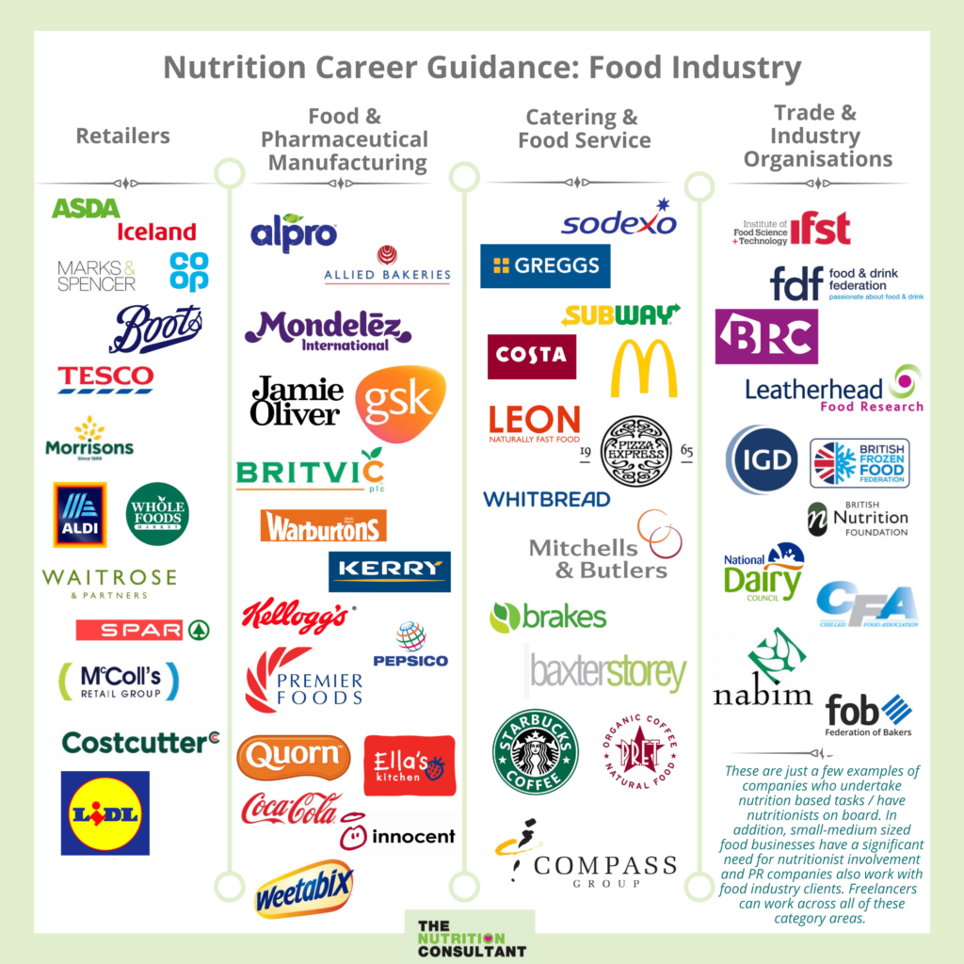
How the course supports future academic pathways or careers.
Careers linked with Food Preparation and Nutrition aren't just limited to going into catering of being a chef!
Careers in the hospitality industry are common and can range from food preparation to management and administration, food styling, food photography and food writing.
The science of food is a big industry in Norfolk and beyond, both researching, creating, testing and manufacturing new food products, but also working on food security, designing and engineering the food of the future to ensure we never run out of food and our crops are safe for future generations. Knowledge of nutrition would benefit students looking to go into careers in the sports industries, such as becoming a personal trainer, sports therapist or professional sportsperson. Careers in care and in medicine also link well, such as those going into childcare or social/health workers, or medicine for example doctors and nurses need a good knowledge of nutrition and dieticians rely on their in-depth knowledge of nutrition to treat some of the most severe dietary conditions.
Food is something we all need, literally, to stay alive. There will always be careers in food.
Further study: work experience or apprenticeship in food-based organisations (see image), A levels in science subjects could lead to degrees in food science or becoming a dietician or working in health. Level 3 courses in catering, hospitality or childcare.
Jobs that use Food and Nutrition - Careers - BBC Bitesize
List of food industry careers to consider (With salaries) | Indeed.com UK

