Slide 1

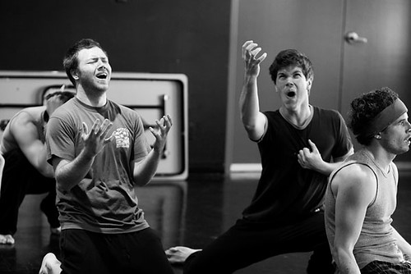
Wymondham
College Options
Subject: GCSE Drama
.

Slide 2


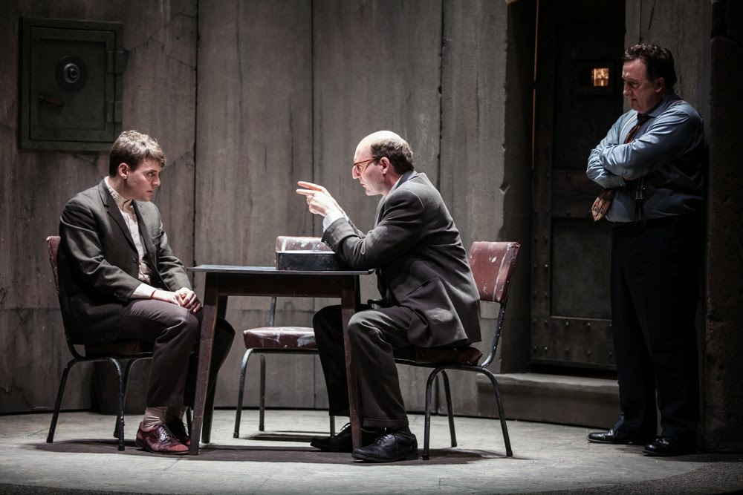
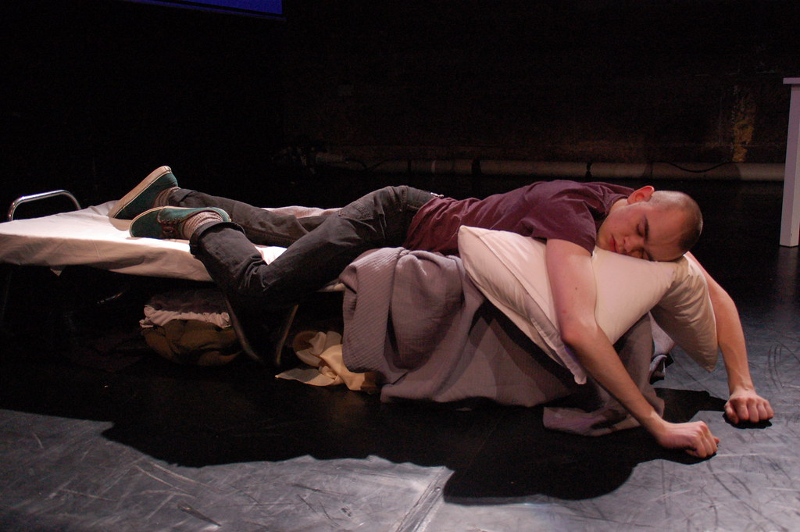
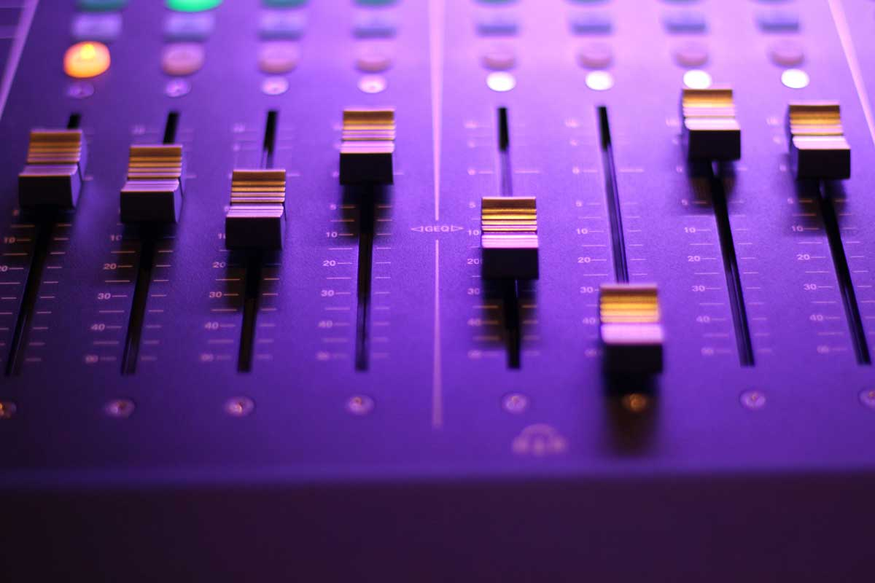
An overview of your subject. Course structure and content.
Unit 1- Understanding Drama
This is a written exam. You will have 1 hr 45 mins. It is in 3 sections; theatre makers, Noughts and Crosses, Live Theatre Review. It is out of 80 marks and is 40% of the overall GCSE.
Unit 2- Devising Theatre.
You will be a performer or a technician. You will be assessed in a practical exam and will hand in a log book about the journey to devise your practical work.
Unit 3- Text
You will study a text and perform two short extracts from this play. You may perform a monologue, duologue or group extract. You must also submit a short statement of dramatic intention

Slide 3

Expectations regarding student commitment, including workload and deadlines. Any coursework or practical elements involved.
You should choose this subject if you can perform in front of a live audience and examiner.
You should choose this subject if you can work well in a team and listen to your peers' ideas.
You should take this subject if you can learn lines easily and/or have prior experience designing stage lighting, sound, set or costume.
You should chose this subject if you do not want your GCSE to be 100% weighted on the final exam.
You should choose this subject if you would prefer to submit coursework that is essay based or an alternative media such as scrap book, video diary etc.

Slide 4

Guidance on how the course supports future academic pathways or careers.
Successful entry to sixth forms, colleges, apprenticeships and industry relies on you conducting a successful interview. Drama GCSE teaches you to have the confidence to talk to people and therefore present yourself well in interview.
It teaches you to consider the meaning behind the way people use their voice, body language and proxemics. This will encourage you to look beneath the obvious and infer meaning from every detail on stage and in others in life. The skill of inferring meaning is also used in many other GCSEs such as History, English Literature and Language, Psychology, Art, Media Studies and Photography.

