Slide 1



Wymondham
College
Options Subject:
Design & Technology
GCSE Design and Technology will prepare students to participate confidently and successfully in an increasingly technological world.
Students will gain awareness and learn from wider influences on Design and Technology including historical, social, cultural, environmental and economic factors.
Students will get the opportunity to work creatively when designing and making and apply technical and practical expertise.
The GCSE allows students to study core technical and designing and making principles, including a broad range of design processes, materials techniques and equipment.
The course is a mix of practical and theoretical knowledge. We want to develop creative problems solvers through this course.
AQA | Design and Technology | GCSE | GCSE Design and Technology

Slide 2

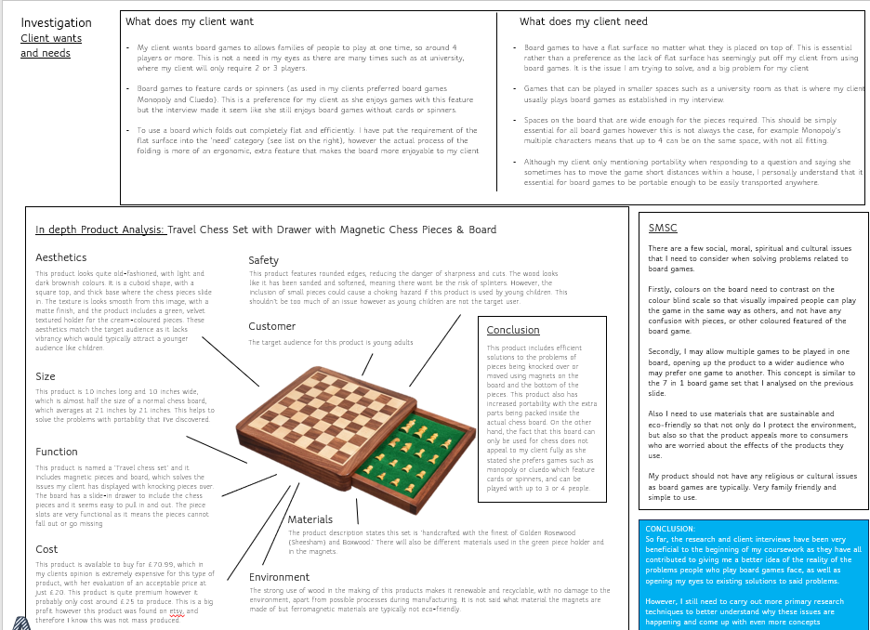
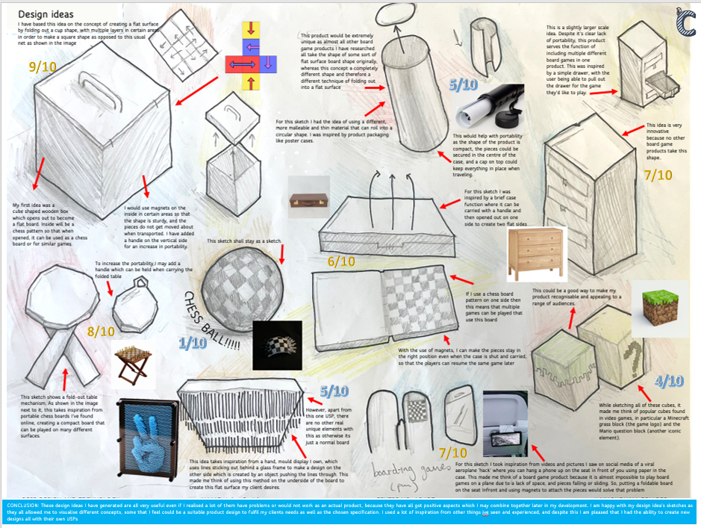
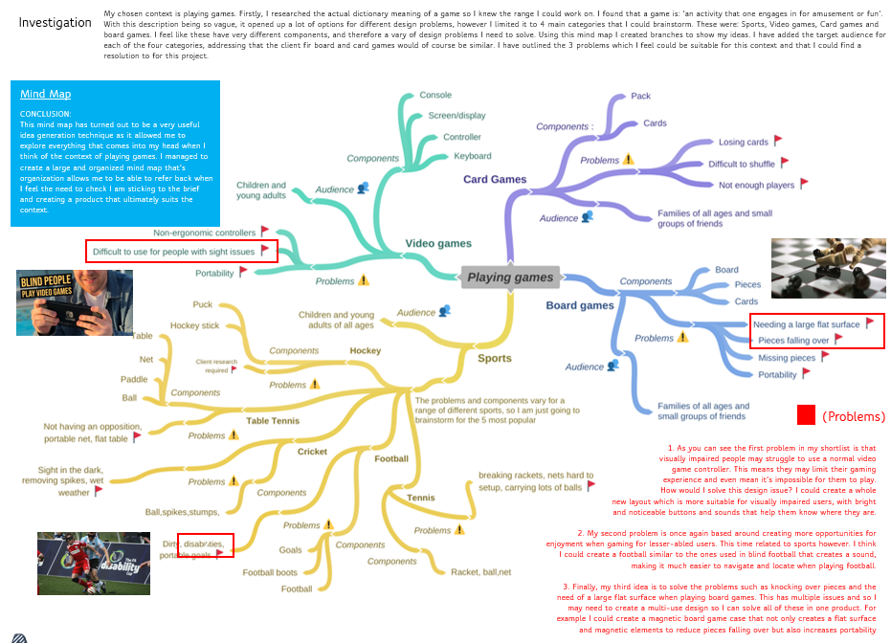
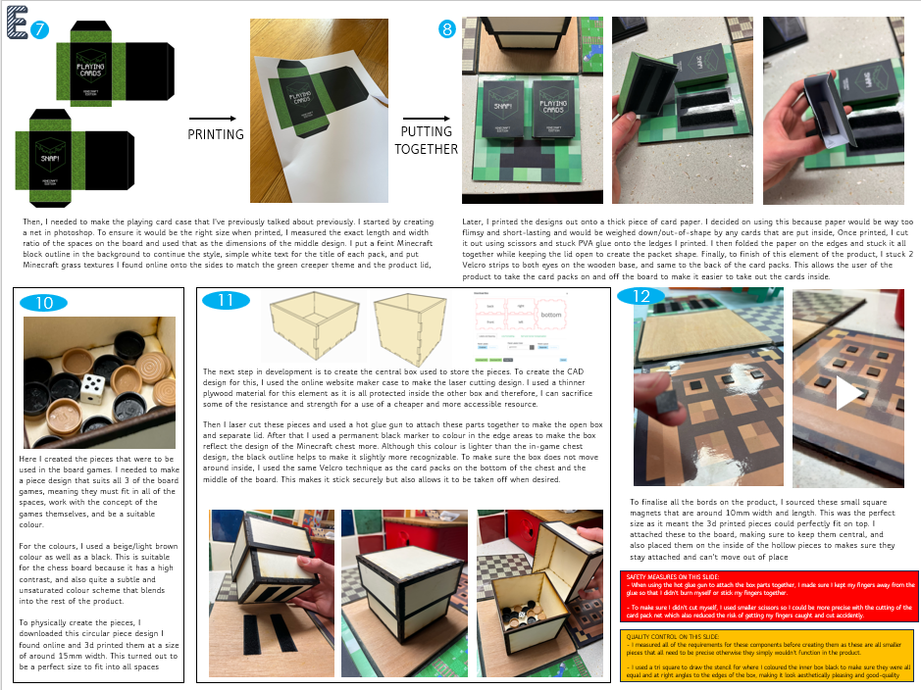
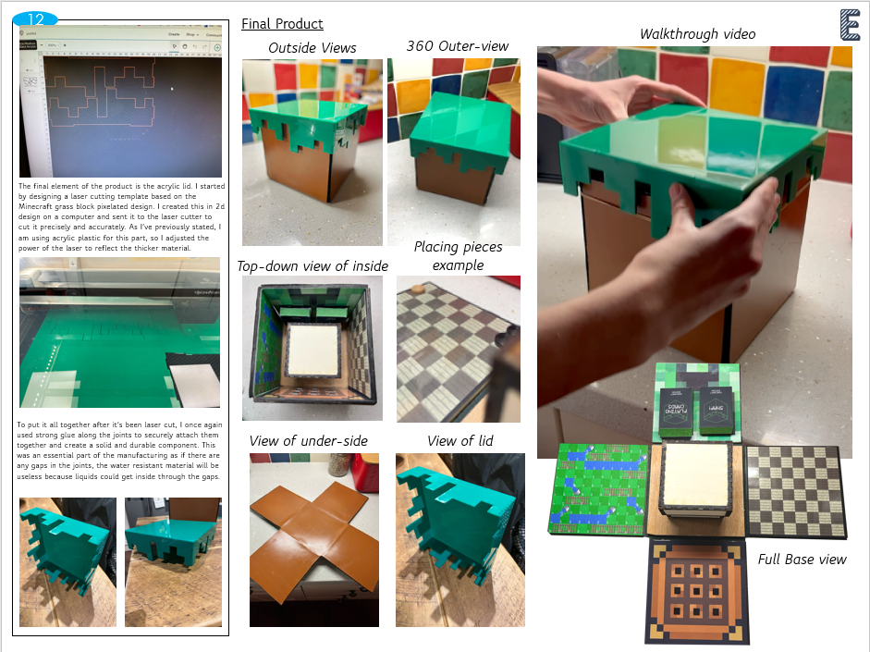
Outline of the course
GCSE: Design and Technology (8552)
NEA (Non-exam assessment) 50%
Written exam (2 hours) 50%
YR9
5 lessons over 2 weeks 2 Theory lessons 3 Skills lessons
YR10
5 lessons over 2 weeks 2 Theory lessons 3 Project lessons
YR11
5 lessons over 2 weeks NEA Lessons from Sept to March Theory & Revision from Easter until Exams
Practical skills based learning including designing and making skills.
Using the range of tools and equipment in the department to improve your skills and knowledge
Using CAD programs to build your presentation skills
Embedded theory throughout, the theory content is fluid with practical lessons throughout.
Stand alone weekly theory lessons
& practice exam questions
Weekly Prep to prepare for working to deadlines.
Projects developing designing, developing and making skills
Practical projects that develop an understanding of the NEA requirements and mark schemes.
Embedded theory throughout, the theory content is fluid with practical lessons throughout.
Stand alone weekly theory lessons
& practice exam questions
Weekly Prep to prepare for working to deadlines.
JUNE – AQA Launch live NEA and release the contexts and actual coursework starts!
Continue with live NEA- hand in Easter
Revision of theory topics throughout with exam questions and independent revision.
Final GCSE exam
WHAT IS THE EXAM LIKE?
The exam is a full written 2 hour exam which will test your understanding of materials, processes and the wider world of design and technology.
Your drawing skills will also be tested.
WHAT IS THE NEA?
The NEA is a 20 page (A3) portfolio of work where you will solve a problem with a user.
You will independently investigate, analyse, design and develop a solution to a problem and evaluate your final product.
You will need to work in-between lessons on your portfolio.

Slide 3










What Skills will I learn?
Design and Technology helps develop skills such as:
Creative thinking.
You will learn how to identify and explore problems and work out solutions.
Technical understanding
You will be able be able to apply your understanding of materials and processes to create innovative solutions.
Communication.
You will develop your design drawing skills and improve your written notes and presentation skills.
Evaluation and decision making.
You will look at strategies for comparing design ideas and manufacturing processes.
You will learn how to use data and graphics to explain decisions.
Computer Aided Design.
You will learn how to create components and produce virtual prototypes using CAD. These may go on to be laser cut or 3D printed.
Design development
You will learn how to use research, testing and investigation strategies to turn ideas into reality and add features that the user needs.
Project planning
You will demonstrate skills in managing a range of activities, such as research, drawing, material experimentation, modelmaking, CAD designs and CAM output.
Environmental awareness.
Any good design work should show an understanding of the way designers can reduce the use of unsustainable materials and create products that use less energy to manufacture and have a plan for their repair or safe disposal.
IS IT RIGHT FOR ME?
Are you:
A creative thinker
A problem solver
Inventive
Passionate about new technology?
Able to think outside the box
Good at designing & making
Able to work to deadlines?

Slide 4

Future academic pathways & Careers.
Careers
Further Study
Mechanical Engineer/Civil Engineer/Systems Engineer /Operations Engineer/
Software Engineer/Big Data Engineer/PHD Research Engineer/
Electrical Design Engineer/Product Development Engineer/Fire engineer/
Weapon Engineer Officer/Scientific Technical Officer/Software Developer /
Technology Consultant/Clinical Support Specialist /Microbiology Technician/
Analytical Scientist/Project Manager/Investment Data Analyst/
Software Developer/Computer Vision Scientist/Quantitative Consultant/
Computer Vision Scientist/IT Business Analyst/Engineering Platoon Officer/
Animator/ Antique dealer/Architect/ Architectural technician/Art editor/
Art gallery curator/Arts administrator/Art therapist/Art valuer/Blacksmith /
Cabinet maker/CAD technician/Cake decorator/Ceramics designer/
Clothing alteration hand/Community arts worker/Conservator/Costume designer/
Design Engineer/Dressmaker/Exhibition designer/Fashion designer/ Fine artist/
Footwear designer/French polisher/furniture designer/Furniture restorer/
Glass Engraver/Glassmaker/Graphic designer/illustrator/Interior designer/
Jewellery Designer-maker/landscape architect/leather craft worker/
Machine printer/Make-up artist/Medical illustrator /Mode! maker/
Museum curator/Musical instrument maker/Naval architect/ Pattern cutter/
Pattern grader/ Photographer/Photographic Stylist/Photographic technician/
Picture framer/Product designer/Prop maker/Reprographic assistant/
Set designer/Signwriter/Stonemason/Tailor/Tattooist/Textile designer/
Textiles production manager/Web designer
……… and more!!
If you have any questions contact Mr Meeson at: j.meeson@wymcol.org
A-Level
University Degree
Apprenticeships
Useful links
What is D&T?
Why is D&T important?
www.icanbea.org.uk
(Norfolk careers website)

