Slide 1

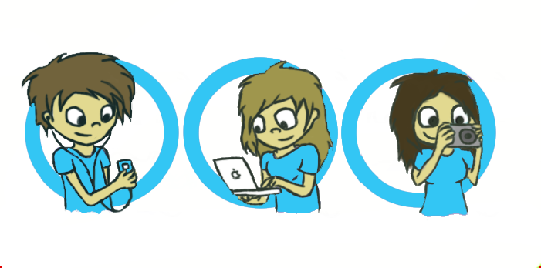
Wymondham
College
Options
SUBJECT: Cambridge National in Creative iMedia

Slide 2
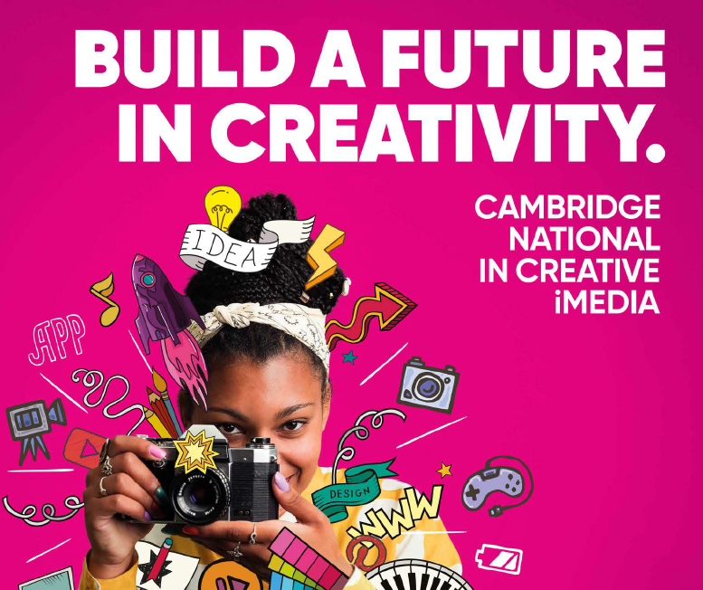

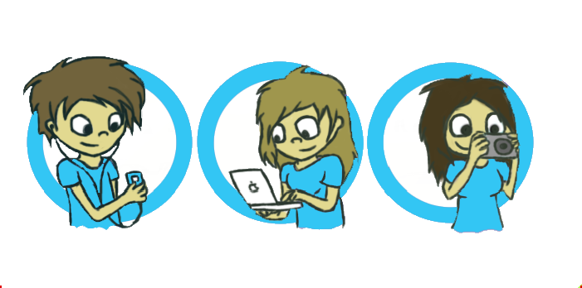


Creative iMedia – What will I learn?
In Creative iMedia you will cover:
How media products get their meaning across, create impact and appeal to people
How to create original digital graphics for specific audiences
Designing and creating original characters and comics
How to plan and create animations with audio
Creating, testing and making playable digital games
Cambridge National in Creative iMedia will inspire and equip you with the confidence to use skills that are relevant to the digital media sector and the wider industry.
It’s a vocational qualification, equivalent in value to a GCSE and contains both practical and theoretical elements.
40% Exam – Creative iMedia in the media industry
25% NEA – Visual Identity and Digital Graphics
35% NEA – Optional Unit TBC
Transferable Skills:
You’ll develop a range of skills to help you succeed not only in the workplace but in other subjects too.
These skills include:
Analytical skills
Digital presentation skills
Creative thinking
Problem solving
Research and planning

Slide 3


Should I Chose Creative iMedia?
Are you:
•Interested in technology?
•Interested in the media industry?
•Resilient when presented with a challenge?
•Creative with a good eye for design?
•Enjoy project work
Creative Technology impacts everything, everywhere
In the United Kingdom, the application of technology helps drive our entire economy, for example:
  Film & TV
    Digital effects, virtual production & streaming platforms.
  Music & Live Events
    Digital mixing, streaming & immersive tech.
  Video Games
    VR/AR, AI characters & 3D modelling.
  Advertising & Marketing
    AI-powered tools & creative automation.
  IT & Digital Software
    Apps, coding & digital content tools.
  Museums & Culture
    Virtual tours & interactive exhibits.
  Publishing
    eBooks, audiobooks & digital magazines.
  Design
    3D modelling, virtual fashion & AI design.
  Architecture
    AR/VR walkthroughs & digital modelling.
  Crafts & Making
    3D printing, laser cutting & online platforms.
  Cultural Events & Tourism
    Immersive digital experiences
Why Creative iMedia?
Develop real digital skills
Hands-on with creative tools
Explore creative industry pathways
Build planning & project skills
Encourages creativity & independence

Slide 4
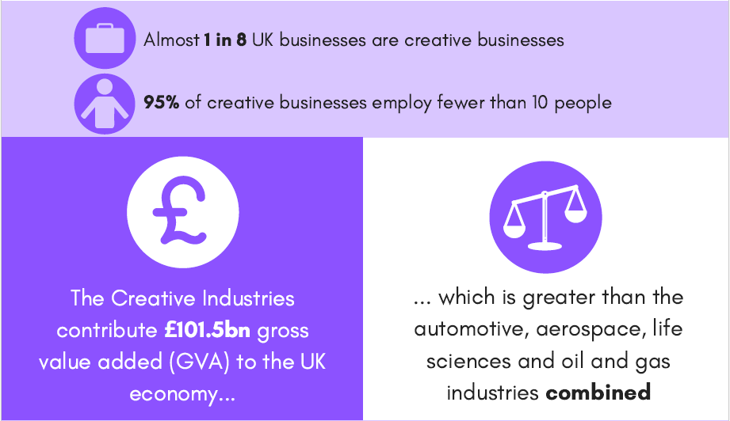

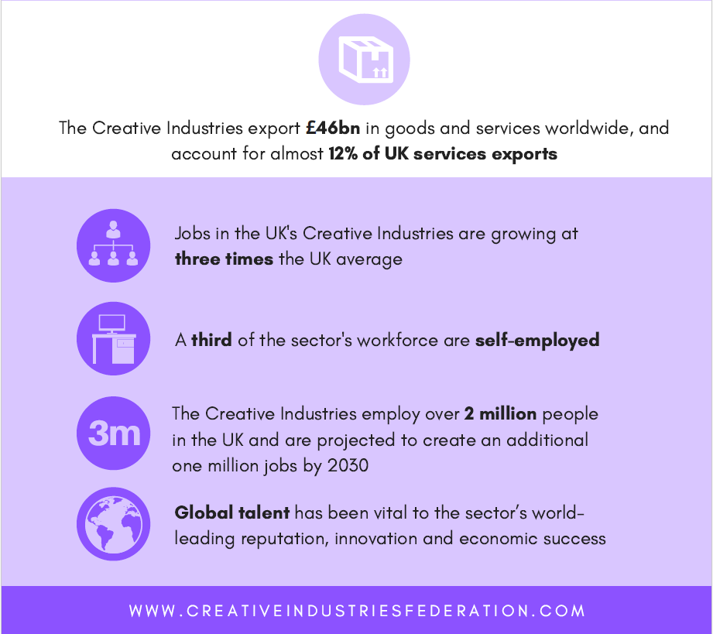
Skills in Digital Technologies can offer you an incredible wide range of jobs and future pathways!
Further Study:
A Levels
Level 3 Qualifications
Higher Education
Level 3 Apprenticeships
Careers Videos – BBC Bitesize
Careers Map - CareersMap_Media.pdf

