Slide 1

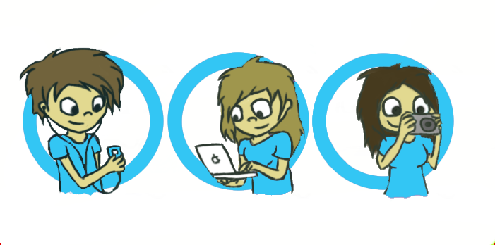
Wymondham
College
Options
SUBJECT: Computer Science – OCR J277

Slide 2
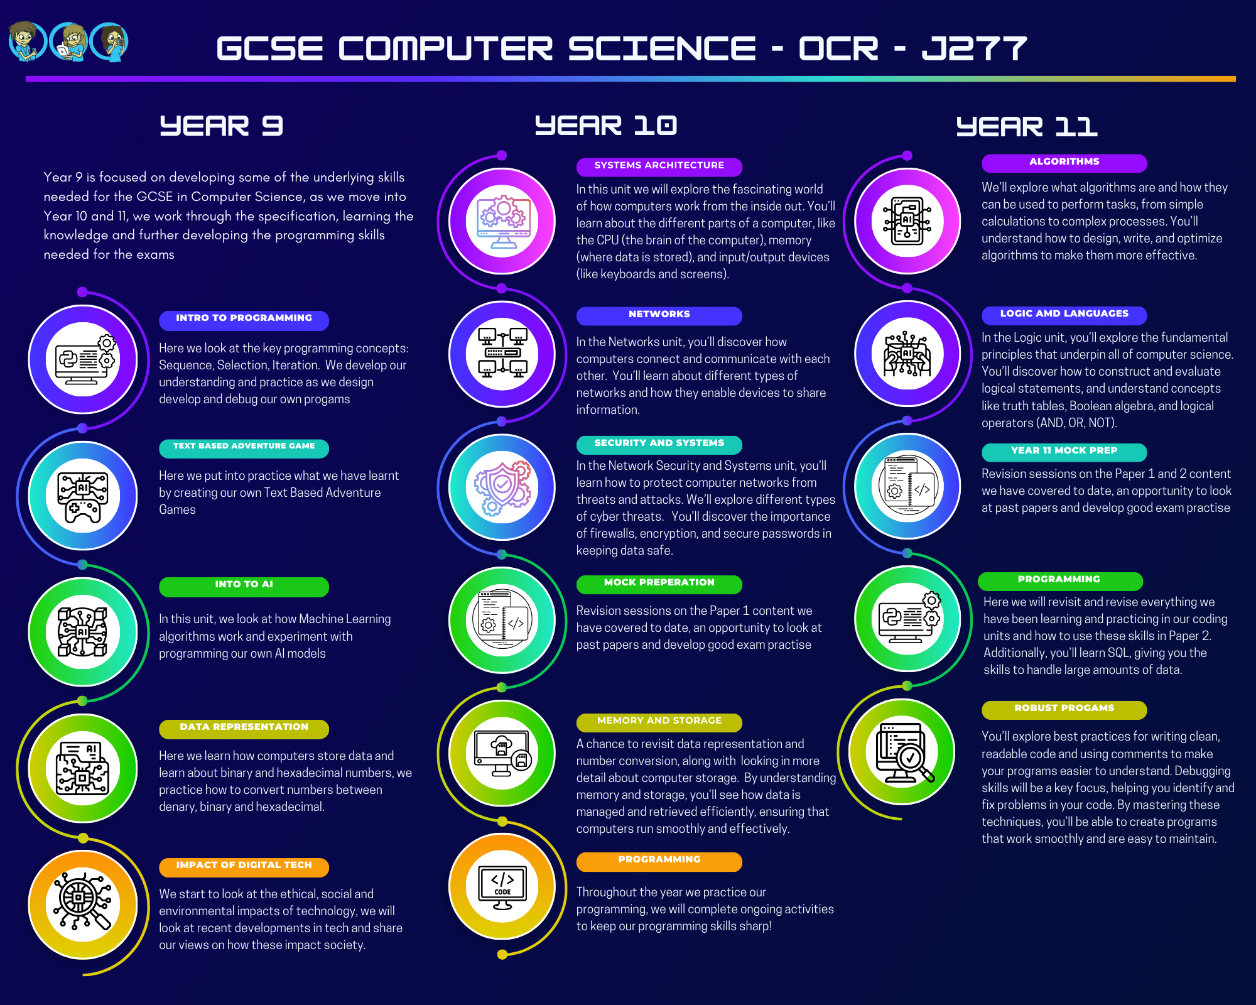

Slide 3
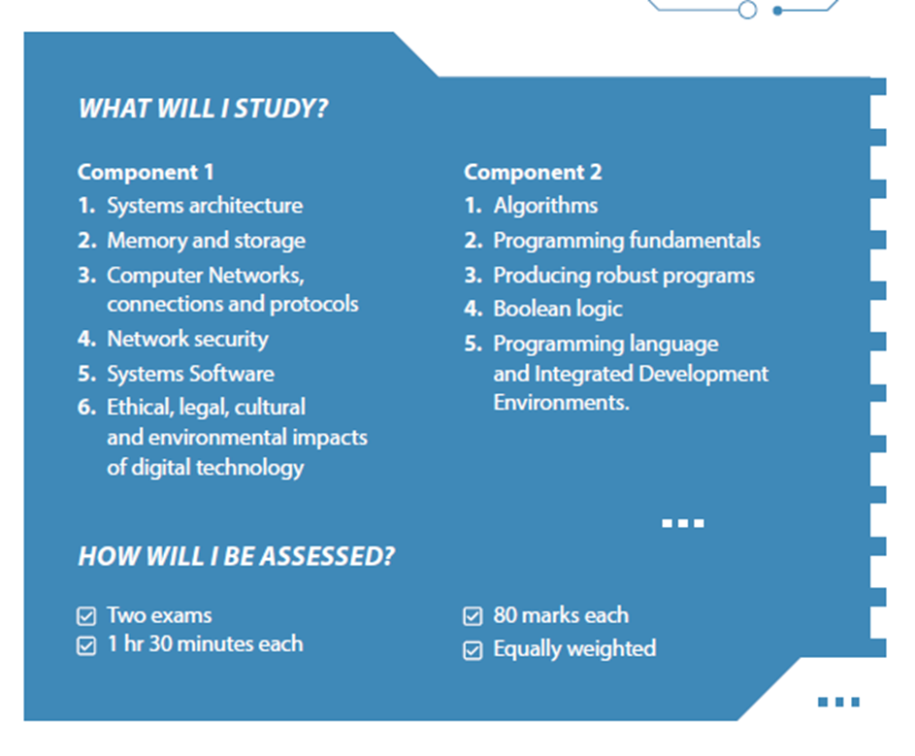
Should I Chose Computer Science?
Are you:
•Interested in technology?
•Enjoy solving problems?
•Resilient when presented with a challenge?
•Creative and Logical?
•Have a good ability in Maths?
Computing and Technology impacts everything, everywhere
In the United Kingdom, the application of technology helps drive our entire economy
Technology impacts every part of our lives:
  Health
  Education
  Environment
  Security and national defense
  Research and development
  Manufacturing
  Tourism and transport
  Entertainment…
Why Computer Science?
Technology is embedded in every aspect of our lives.
Computer Science is being used help solve many of the world's biggest problems

Slide 4


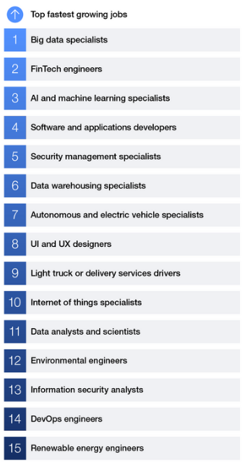
Skills in Computer Science can offer you an incredible wide range of jobs!
There are hardly any job sectors which don’t make use of skills related to:
- Information Technology
- Computer Science
Further Study:
A Levels
Level 3 Qualifications
Higher Education
Level 3 Apprenticeships
Careers Videos – Find out more about some of the careers in Computing here and on BBC Bitesize
These are just some of the roles in Computing, they span various industries, from healthcare to entertainment:
Software Developer: Design, code, test, and maintain software applications.
Web Developer: Create and maintain websites and web applications.
Mobile Application Developer: Develop apps for mobile platforms like iOS and Android.
Data Scientist: Analyse and interpret complex data to help organizations make decisions.
Database Administrator: Manage and maintain databases to ensure data security and availability.
Machine Learning Engineer: Develop algorithms that enable machines to learn from data.
Cybersecurity Analyst: Protect systems and networks from cyber threats.
Information Systems Manager: Oversee the IT needs of an organization.
Network Engineer: Design and manage computer networks.
AI Researcher: Conduct research to advance artificial intelligence technologies.
Game Developer: Create video games for various platforms.
Systems Analyst: Analyse and design technology solutions to meet business needs.
IT Consultant: Provide expert advice on technology solutions.
Cloud Engineer: Design and manage cloud computing solutions.
DevOps Engineer: Bridge the gap between software development and IT operations.
UX/UI Designer: Design user interfaces and experiences for digital products.
Robotics Engineer: Develop robots and robotic systems.
Health Informatics Specialist: Manage and analyse health data.
Bioinformatics Scientist: Apply computer science to biological data.
Animator: Create computer-generated animations for films, games, and other media.

